Slide 1
Tutorial 7

Slide 2
Question 1: Two T flip-flops are connected so that T_{A} = Q_{A}+Q_{B} and T_{B} = Q_{A}’ + Q_{B}. Write out the state table for this circuit and specify its count output.
Question 2: Use a timing diagram with 8 clock pulses to describe the operation of the counter below. Assume that the JK flip-flops are all initialized to 0.

Slide 3
Question 3: With the aid of a timing diagram, determine the sequence of the counter below. Assume the D flip-flops are all initialized to 0.
Question 4: Analyse the following
circuit and determine the count
sequence of the counter.

Slide 4
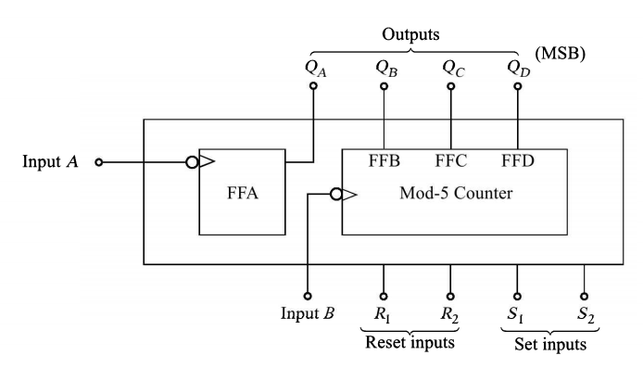
Question 5: A 7490 counter IC has two counters (MOD 2 and MOD 5) as shown in figure. If QA output is connected to B clk input and the clock is applied to the A input determine the count sequence of the counter.

Slide 5
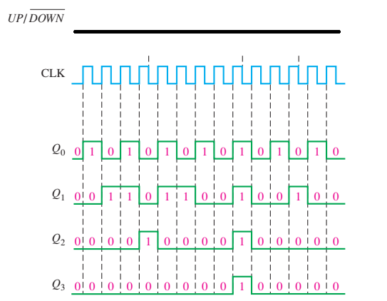
Question 6: The timing diagram of a 4-bit synchronous binary up/down counter is shown below. Assume that the counter starts in the all-0s state and is positive edge-triggered. Find out and draw the up and down control signal.

Slide 6
Question 7: Assume that a five-bit binary counter starts in the 00000 state. What will the counter state after 182 pulses?
Question 8: A binary counter is being pulsed by a 512 kHz clock signal. The output frequency from the last flip-flop is 4 kHz. Determine (a) the MOD number and (b) the counting range.
Question 9: Use J-K flip-flops and any other necessary logic to construct a MOD-24 asynchronous counter.

